Slide 1
MASTERING DOCUMENT AUTOMATION
Andy Sheppard, MAI
Principal
Pritchett, Ball & Wise, Inc.

Slide 2
OVERVIEW OF TOPICS COVERED
WHY DO APPRAISERS NEED AUTOMATION?
WHAT “CANNED” SOFTWARE IS OUT THERE?
WHAT THINGS CAN YOU AUTOMATE?
MAKING YOUR SOFTWARE DO MORE (“DIY”)

Slide 3
WHY APPRAISERS NEED “AUTOMATION”
CONSISTENCY
Repeat Same Values Throughout
Manage Sentence Tense/Person Agreement Issues
Fix Innocuous Things that Look Bad if Done Incorrectly
SPEED
A Good Template Becomes “Fill in the Blanks” vs “Hunt & Peck”
Make Mass Changes at Once
Make Mass Corrections at Once
REPETITION
Helps Reader Not Have to Flip To/Fro
Recapitulating Facts Makes You Seem Organized/Competent
Typing the Same Thing, Over and Over, is BORING

Slide 4
“CANNED” SOFTWARE
No Shortage of Options…
- Alamode (Residential)
- Appraiser’s Paradise
- AppraiseWrite
- Commercial Complete
- Datappraise
- Narrative One
- Report Builder Pro

Slide 5
“CANNED SOFTWARE”
Things to Look for When Choosing Software:
- Admin versus Appraiser Cost Difference
- Annual Fee or One-Time Purchase
- Accessible via Server Only
- Accessible Online (Only or Additionally)
- Ability to Add New “Fields”
- Ability to Handle Multiple Premises

Slide 6
THINGS YOU CAN AUTOMATE
AUTO TEXT ENTRIES
One-Click Loading - Proposal, Invoice, Etc. Templates
Text Changes (i.e., +- becomes ±; SF becomes ft², etc.)
Change Boilerplate Based on Specific Property
Specific Text for Specific Clients
Specific Text for Yellow Book Standards
“Methodology” Text for Apartments, Industrial, Etc.
“Improvement Analysis” for Apartment, Industrial, Etc.
“Land Sale Template” (Long and Short Formats)
“Improved Sale Template” for Apartment, Retail, Etc.

Slide 7
AUTO-TEXT PRIMER
EASIEST TO USE
- NOMINAL* SETUP
- USE EXISTING TEXT/TEMPLATE/GRAPHICS
- EASY TO CHANGE/UPDATE
- INSERT AS NEEDED
AUTO TEXT IS UNDER “QUICK PARTS”
ON THE “INSERT” TAB/MENU

Slide 8
AUTO-TEXT PRIMER
VIDEO
MAKING AUTO TEXT
FROM EXISTING FILES

Slide 10
AUTO-TEXT PRIMER
VIDEO
INSERTING AUTO TEXT
INTO DOCUMENT

Slide 12
THINGS YOU CAN AUTOMATE
“MACROS” CAN AUTOMATE PROCESSES:
Resize Photos to Fit 2/Page, 6/Page, Full Page, Etc.
Insert “Landscaped” Page (w/o Pages Going Haywire)
“Ask” for Inputs (i.e., Client Info, Etc.) upon Opening
“Lock” Portions of a Document from Edits
Highlight Misspelled Words (Instead of Thin Red Lines)
Add Current Headers, Footers, Qualifications, Etc.
Add Predefined Named Files (i.e., “LS_Map.jpg”)
“Pull” Data from Excel, Access, Etc.

Slide 13
MACRO PRIMER
VIDEO
USING MACROS
TO RESIZE PHOTOS

Slide 15
MACRO PRIMER
SETTING UP COMPUTER
TO USE/MAKE MACROS

Slide 16
MACRO SETUP

Slide 17
MACRO SETUP

Slide 18
MACRO SETUP

Slide 19
MACROS PRIMER

Slide 20
MACROS PRIMER

Slide 21
MACRO EXAMPLES

Slide 22
MACROS PRIMER

Slide 24
DIY AUTOMATION
GREAT ALTERNATIVE IF YOU WANT TO…
- Stop Typing the Same Words, Over and Over
Acres? Address? County? I/We?
- Stop Making Verb Tense Changes by Hand
… appraiser opines / appraisers opine
- Stop Doing Math by Hand/Excel/Calculator
Create Calculations within Word

Slide 25
DIY AUTOMATION
GREAT WEBSITES & REFERENCE BOOKS:
“Word 2010: Inside Out” by Katherine Murray
gregmaxey.mvps.org (MS Word Tips Link)
word.mvps.org (ALL)
gmayor.com (Word Pages & Downloads)
LMGTFY.com

Slide 26
DIY AUTOMATION SETUP
THE NEXT SLIDES SHOW YOU HOW TO:
“SEE” BOOKMARKS (NOT ON BY DEFAULT)
“SEE” FIELD CODE SHADING (“” “”)
PREVENT/ALLOW UPDATING ON FILE ENTRY
PREVENT/ALLOW UPDATING ON PRINT

Slide 27
DIY AUTOMATION SETUP

Slide 28
DIY AUTOMATION SETUP

Slide 29
DIY AUTOMATION SETUP

Slide 30
DIY AUTOMATION SETUP

Slide 31
DIY AUTOMATION PRIMER
“BOOKMARK” IS A THING THAT REPEATS
“CROSS REFERENCE” IS A LINK TO BOOKMARK
BOTH ARE LOCATED ON THE INSERT MENU
BOTH ARE DOCUMENT SPECIFIC

Slide 32
DIY AUTOMATION PRIMER
“FIELD CODE” MAKES THE MAGIC HAPPEN
SHOWS UP AS GREY-HIGHLIGHTED TEXT
GREY DOES NOT SHOW UP WHEN PRINTED
SHIFT F9 SHOWS CODE FOR SINGLE WORD
ALT F9 SHOWS ALL CODES IN DOCUMENT

Slide 33
DIY AUTOMATION PRIMER
“FIELD CODE” INSERTION
AUTOMATICALLY BY CROSS REFERENCING
MANUALLY BY CTRL F9 ( )
PROGRAMMATICALLY BY MACROS

Slide 34
DIY AUTOMATION PRIMER
“FIELD CODE” CALCULATIONS AND USES:
IF/THEN TYPE CHANGES
“Appraiser1”=Mike; “Appraiser2”=BLANK SPACE
{ IF Appraiser2 = “” “appraiser” “appraisers” }
…unit of comparison is price per SF (“UOC_Land”)
{ IF UOC_Land=“SF” “/SF of land area” “/Acre” }

Slide 35
DIY AUTOMATION PRIMER
“FIELD CODE” CALCULATIONS AND USES:
SIMPLE MATH
“Subj_FMV”=$1,000
{ = Subj_FMV * 0.40 \# “$#,###” }
LAYERED MATH
(INSURABLE VALUE EXAMPLE)

Slide 38
DIY AUTOMATION PRIMER
“FIELD CODE” SWITCHES FOR TEXT:
XXX

Slide 39
DIY AUTOMATION PRIMER
“FIELD CODE” SWITCHES FOR #S TO TEXT:
\* CardText \* Caps (72 ➔ Seventy Two)
\* Roman (11 ➔ XI)
\* OrdText (1 ➔ 1st)

Slide 40
DIY AUTOMATION PRIMER
“FIELD CODE” SWITCHES FOR CALCS TO #S:
\# #,### (8.2253*43560 ➔ 358,294)
\# #,###.## (8.2253*43560 ➔ 358,294.07)
\# #,###.00x (8.22253*43560 ➔ 358,294.068)
\# “$#,###.00 ‘ in taxes’ “ ($12.34 in taxes)
\# “##%” ($1 EXP / $3 EGI ➔ 33%) WATCH OUT

Slide 42
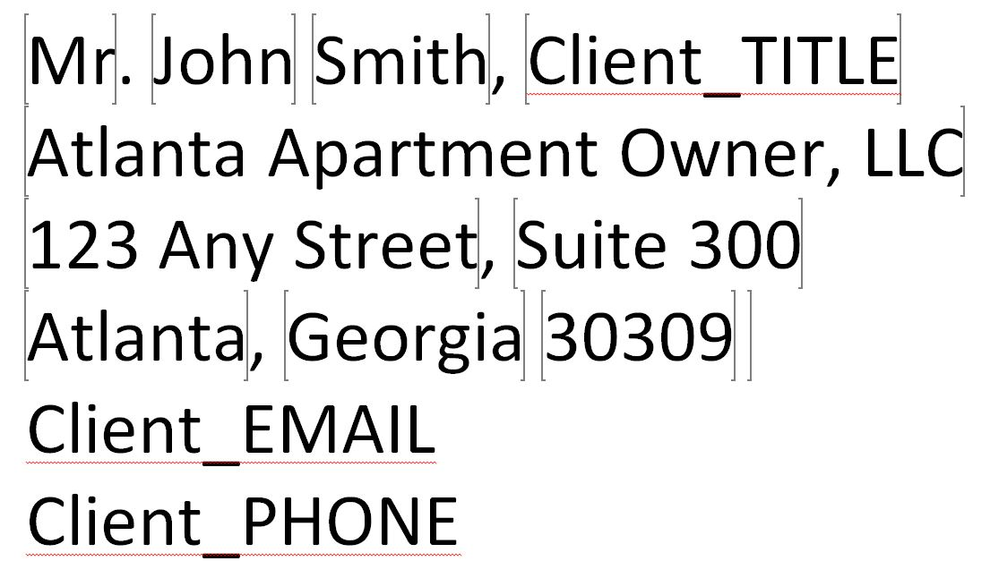

Slide 43
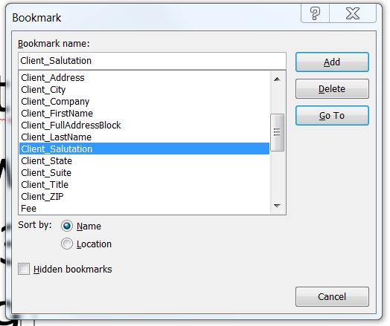

Slide 44
MACRO PRIMER
VIDEO
MAKING A NEW
BOOKMARK

Slide 46
MACRO PRIMER
VIDEO
ERROR HANDLING
WITH FIELD CODES

Slide 48
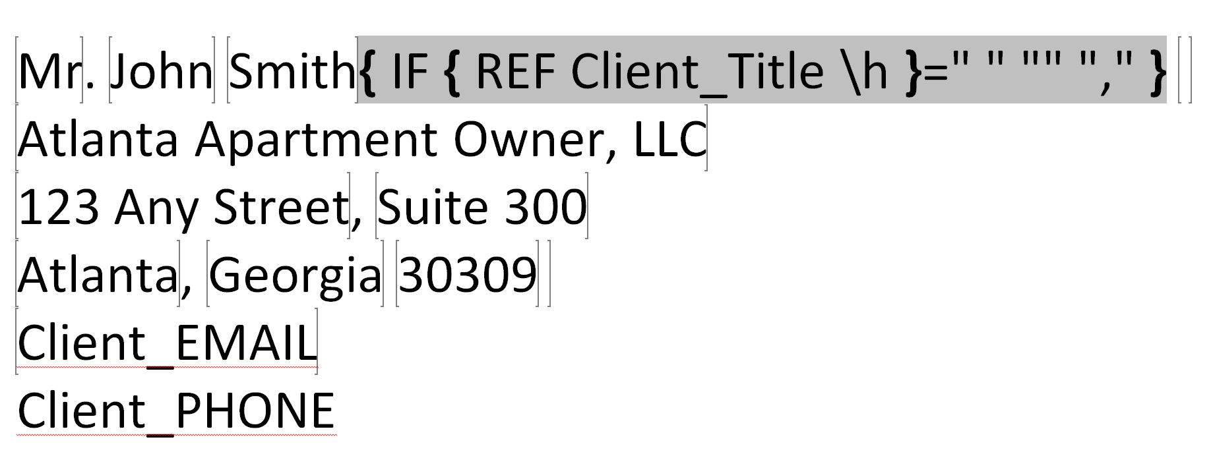

Slide 49
DIY AUTOMATION PRIMER
CONSIDERATIONS / BEST PRACTICES:
Start Small (appraiser vs appraisers; acres ➔ SF)
Involve Your End Users in the Process
Find Reasons to Add New Bookmarks
Put Bookmarks in the FRONT of the Report
Name Bookmarks w/ Logical Prefixes
Pay Attention to Word vs Excel re: Rounding
Bookmark Calculations – Never Repeat a Calc
Error Handling is a Necessity

