Slide 1
Appraising Industrial Properties Mastering Appraisal Fundamentals Atlanta Area Chapter of the Appraisal Institute August 6, 2015 – Atlanta, Georgia
George S. Petkovich, MAI, CCIM
Pritchett, Ball & Wise, Inc.
george@pbwatlanta.com
www.pbwatlanta.com
(404) 874-4496

Slide 2
Office Buildings Big Bucks and Swanky Digs

Slide 3
Retail Chic and Sexy

Slide 4
Industrial You Must Have ____ for Brains (Its Actually A Little More Sophisticated Than This)

Slide 5
Industrial Market Overview 2nd Quarter 2015 Statistics from King Industrial
What does that tell you if you are appraising a vacant,45-Year Old and 18,000 sf Office Warehouse in the Chattahoochee Industrial?
A 28-Year Old 102,000 sf Truck Terminal in Rockdale County?
A proposed 850,000 sf B2C E-Commerce Fulfillment Center in Henry County?
I’m Not Really Sure!

Slide 6
The Defining Characteristics of the Industrial Market? Segmentation, Specialization and Diversity!
General Classifications:
Business Service / Service Center / Flex: Typically smaller spaces, office intensive, low clear heights and drive-in doors.
Business Distribution: Medium sized buildings, often multi-tenant, Less than 20% office, ceiling heights 16’+.
Bulk Warehouse: Larger Facilities (100,000+ sf), less than 10% office, high ratio of dock doors, often have rail doors, high ceilings (often 30’+ for newer buildings).
Other Market Segmentation:
Location (driven by market served), access, (also driven by market served), age, quality, size, construction type, lot size / coverage, special physical characteristics, etc.

Slide 7
Market Delineation
Some sectors may be in oversupply while shortages might apply to others.
As an example, focusing in on existing 300,000+ sf facilities built since 2000, CoStar shows a 6.1% current vacancy rate, which is lower than the 12.5% rate shown only for smaller flex buildings of all ages.
The right product can weather the storm!

Slide 8
Specialized Uses (Partial Listing)
Light Manufacturing, Heavy Manufacturing, Food Processing, Showroom, Freight (Truck Terminal & Air Cargo), Cold Storage (Refrigerated and Freezer), R&D, Laboratory, Telecommunications (Data / Switch Center), …
What is the Takeaway?
The potential use of an industrial building is a function of its physical character and depending upon features may be narrowly segmented.
Likewise, the competitive set for a specific industrial building may be narrowly segmented.

Slide 9
Factors Influencing the Market(s)
Urban submarkets: Often occupied by locally owned businesses needing specific locations to serve their customers. An example would be a restaurant supply business needing to be near the customers they are serving. Special physical characteristics are not that great a need. Older buildings are OK especially if they are cost effective. Often local and entrepreneurial ownership of the real estate.
Competing forces in more popular areas include loft (typically office / residential) conversions, retail / showroom conversions and increasing land values for redevelopment. An Interesting phenomenon is occurring where business owners fight re-zonings away from industrial in order to maintain the integrity of shrinking industrial districts.
Highest and best use analysis considering redevelopment as improved or demolition for new construction increasingly important.

Slide 10
Market Factors Continued
Close in Suburban Markets: Depending upon specific location these submarkets might be affected by similar issues as compared to urban markets, but buildings tend to be larger, newer and more functional as compared to urban markets. Mix of local and national tenants and a mix of ownership including local and national real estate companies and international investors.
Also home to much of the service / flex market, which competes with Class B and Class C office space. There has been no significant recent development of flex space as demand has been slack and vacancy rates high. However, as the office market continues to improve and rates increase more businesses may begin moving to flex space to save money.

Slide 11
Factors Influencing the Institutional Industrial Market
Institutional grade industrial space was one of the first real estate sectors to recover. This has lead to securitization and significant inflows of capital, especially from REITS, private capital, pension funds and insurance companies. This has driven down yields and created a new development cycle.
Institutional grade buildings are bigger, newer, more functional, and have specialized features (discussed in greater detail later). They tend to be located along major interstate corridors in suburban areas. These buildings have experienced the bulk of new demand, which is driven by large users and represent the bulk of new construction in Atlanta and other major industrial markets.

Slide 12
Factors Influencing the Institutional Industrial Market - Continued
Supply Chain Management: Managing the flow of raw materials, work in process inventory and finished goods is becoming increasingly sophisticated as companies seek to earn operating advantages by lowering costs and increasing efficiencies. This includes reducing inventories through “Just in Time” production systems. There are tradeoffs between freight costs, inventory costs and labor costs.
Globalization: Off shore production, imports and exports are all growing with major increases in volumes shipped being experienced by most ports. Shipping containers are moving increasingly quickly from ships, to trucks and trains via intermodal facilities feeding Atlanta area warehouses and distribution centers.

Slide 13
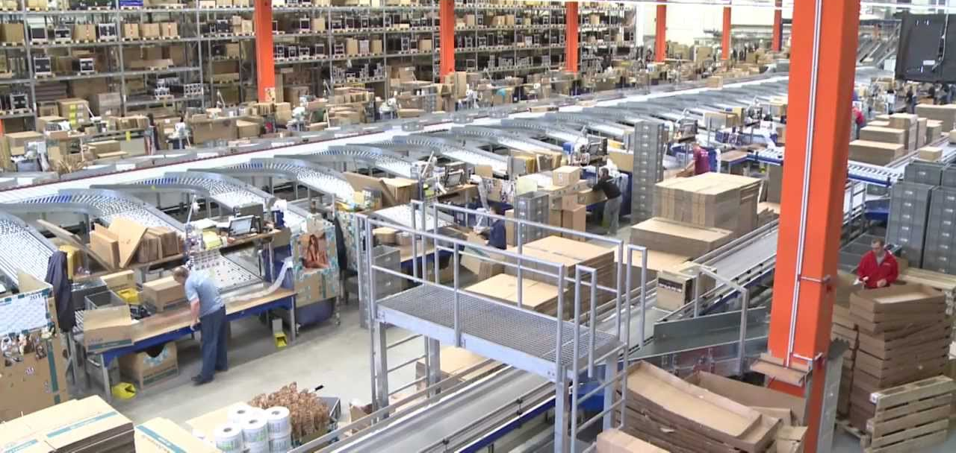
Factors Influencing the Institutional Industrial Market - Continued
E-Commerce: Companies are trying to fulfill on-line orders to businesses and consumers in an ever quicker, more cost effective and reliable fashion in order to be able to compete more effectively with “Brick and Mortar” companies using a traditional business model. E-Businesses are seeking specialized buildings to serve these often labor intensive and highly automated facilities.

Slide 14
Trends in the Industrial Market
According to a recent published interview in Globe St.com, according to Ron Washle, Senior Managing Director with Newmark Grubb Knight Frank, “The biggest changes over the past 15 years are the dramatic growth in building size and efficiencies. Fifteen years ago, 400,000 to 500,000 sf was big in an industrial building. Five years ago 700,000 sf was considered large, and today we are seeing speculative industrial product being delivered in the range of 1.2 to 1.3 million square feet…In the past, the typical clear height requirement was 30 feet. Now we are seeing a 36-foot minimum clearance”.

Slide 15
Features Defining Modern Industrial Facilities (High Cube)
High Clear Height: Most large new facilities have clear heights (distance from the floor to the lowest hanging structural or other hanging member) of at least 30’ with some exceeding 36’. High clear heights allow greater storage using pallets in higher racks lowering storage costs, with the 36’ height representing the minimum for five pallet storage.
Super Flat Floors: High racks and high lifts for reach trucks make super flat floors a necessity, as minor imperfections can create instability. Floor loading capacity needs are increased with floor slabs of at least 6 inches or greater.

Slide 16
Features Defining Modern Industrial Facilities (High Cube)
Most often using tilt-up or pre-cast wall panels.
50’ to 56’ column spacing (increases with height).
A ratio of at least 1 dock door per 10,000 sf, with dimensions of at least 9’ wide by 10’ for docks and larger for drive-ins. Many users require cross dock facilities with ratios as low as 1 per 5,000 sf. Dock levelers are also helpful to speed loading.
Adequate 3 phase power, depending upon size and use.
Adequate lighting, often using long-life high discharge metal halide units or modern fluorescent lighting.
Enhanced fire suppression through early suppression fast response (ESFR) sprinklers.
Truck courts sufficiently wide for a turning radius of 120’ to 130’.

Slide 17
Features Defining Modern Industrial Facilities (E-Commerce)
These are often pass through facilities requiring cross docking and a relatively higher number of doors allowing simultaneous movement of cargo or goods.
Fiber optic cabling often required for call / data volume.
Often have high parking requirements as these facilities are highly populated on a 24-hour basis.
As a result of the numbers of workers these facilities often need a higher ratio of office / administrative space.

Slide 18
Other Industrial Product Types Specialized Feature Overview
Refrigerated: Freezer floors a unique feature. Depending upon design of the floors these buildings may or may not be easily converted to other uses. Interior dock doors often used, especially in warmer climates. Typically lower parking requirements and less need for truck storage. Heavy power, dual sprinkler systems and floor drains are required.
Manufacturing: High power requirement. Floors need strength for heavy equipment. Often need or require cranes. Dock door requirement typically lower as compared to distribution uses. Parking requirement typically higher. Rail service often important and proximity to labor, raw materials and natural resources important.

Slide 19
Other Industrial Product Types Specialized Feature Overview
Office showroom: Locations in high traffic areas with good exposure work best. 100% HVAC and larger components of office space. Very high clear heights and total number of doors less important, although dock and drive-in tend to be useful with rear loading preferred. Higher exterior and interior finish typical.
Freight: Truck Terminals are not warehouses. Need to be cross docked with a very low square foot per dock ratio (typically 500 sf to 1,000 sf) needed. Tend to be rectangular and narrow with a typical width of 60’. Typically smaller buildings (less than 100,000 sf) but need low site ratio coverages for truck parking.
Telecommunications facilities, data centers, labs and other similar facilities fall in the industrial category but all have specific physical requirements.

Slide 20
Appraisal Process
Property inspection: It is especially important to identify and document physical features as they drive specific use. Measurement of large facilities can be difficult. Laser rulers and rolling wheels helpful. Often can identify specific architectural features via spot measurement that can help calculate total size. On-line aerial tools helpful as backup.
Market analysis: Product productivity, market delineation, forecast demand, competitive supply analysis, equilibrium or residual analysis, and forecast of subject capture.
Highest and Best Use: Vacant and improved. Four tests. Often not enough to conclude “Highest and Best Use is for Industrial Use”. Often need to drill down to specific uses.

Slide 21
Valuation It all Starts with the Land
Specific Factors to Consider as a Basis of Comparison
Location: Access to transportation, access to markets, access to related businesses, access to labor, access to natural resources.
Site size and layout: Will the site allow for a typical land to building ratio? Will it accommodate typically shaped buildings and adequate truck maneuverability?
Zoning: Will it allow the specific use under consideration? Is the zoning unduly restrictive?
Topography: Industrial typically needs large sites that are level or are graded. Is the site usable? Are there above standards costs associated with development? It is tricky comparing raw and even rough graded parcels.

Slide 22
Excess vs. Surplus Land (It’s Been So Long it is Easy to Forget)
Excess Land: Land not needed to support an existing improvement or land not needed to support a vacant site’s primary highest and best use. May be subdivided and has it’s own highest and best use.
Surplus Land: Associated with an improved site. Additional land that allows for future expansion of the existing improvement. Cannot be developed separately.

Slide 23
Valuation as Improved Factors Specific to Industrial Properties
Sales Comparison Approach: Uniqueness as reflected in market segmentation. While many industrial buildings are “generic” as discussed there are many specific property types. It is an appraisal judgment as to whether it makes more sense to compare relatively dissimilar properties within the same market or to expand a search to a regional or national basis.
Income Approach: Industrial leases can be structured in a variety of different ways using terminology that may mean different things to different people. While a “triple net lease” seems clear, are expenses directly paid by the tenant or passed through from landlord? If CAM is passed through, what is included? If it is a modified gross lease are there pass throughs above a base year? Read the lease(s) for your subject. Get specific lease structures for your comps.

Slide 24
Valuation as Improved Factors Specific to Industrial Properties - Continued
Cost Approach: Useful in valuating relatively new properties and unique properties. However, depending upon specific features and characteristics comparative unit / calculator method may be too vague or broad. May need to do a more detailed unit in place or segregated cost analysis, unless you want to end up being that guy.

Slide 25
Environmental Contamination
Of the major property types contamination is most likely to impact industrial because of the types of uses.
Don’t hide behind your Assumptions and Limiting Conditions. You may not be an expert but you have a duty to raise “red flags”.
Extraordinary assumptions and hypothetical conditions have to be appropriate for the assignment and be clear to the reader.

Slide 26
Conclusion – Appraising Industrial Properties A Complex and Diverse Field
Users of industrial properties are becoming increasingly sophisticated as they realize how real estate effects their “bottom line” on multiple levels.
Industrial Market participants, including investors, developers and brokers are becoming increasingly specialized and more knowledgeable.
Appraisers in this field need to stay informed and well trained. We need to become that guy!

