Slide 1
Fundamentals of Valuing
Office Buildings
John W. Cherry Jr., MAI, CRE
Managing Director
Valuation & Advisory Services
August 6, 2015

Slide 2
Presentation Overview
History of the Office Building
Atlanta Market Overview
Market Analysis Overview
The Cost Approach
The Sales Comparison Approach
The Income Approach
  Interview with Bob Voyles and Will Yowell
  Direct Capitalization Issues
  DCF Issues
Appraisal “Curve Balls”
Q&A Session

Slide 3

History of the Office Building
“The King was in his counting house, counting his money…”

Slide 4


History of the Office Building
Some early examples of offices in palaces:

Slide 5
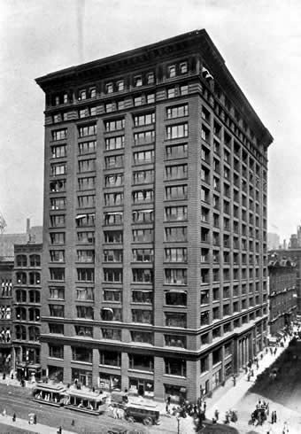

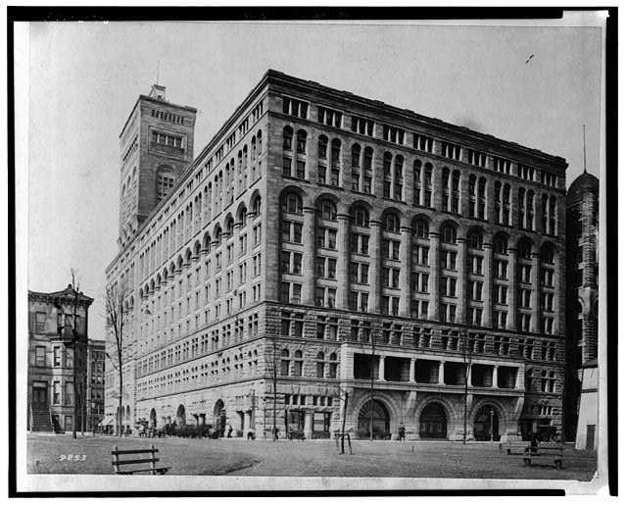
History of the Office Building
Emergence of the modern office:
Modern Capitalism
Technology
Engineering (The flush toilet, the elevator, and skeletal construction)
Architecture

Slide 6


History of the Office Building
Emergence of the modern office:
Multi-tenant Demand
Central Business Districts and Flatiron Buildings

Slide 7


History of the Office Building
Ultra Modern Office Space:
Open Floor Space, Collaborative Environments
Unconventional design, unique features

Slide 8


Atlanta Market Overview
Atlanta
Market Drivers
In-Migration
Atlanta is the epicenter of the Southeastern United States, drawing an estimated 52% of the nation’s net migration.
Access & Distribution
Atlanta is at nexus of three major interstate corridors, within a day’s drive of all of Florida, the world’s largest passenger airport, the east coast’s fastest growing port (Savannah) and CSX & Norfolk Southern intermodal facilities.

Slide 9

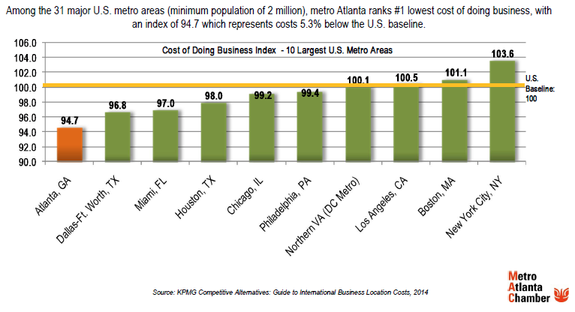
Atlanta Market Overview
Atlanta
Market Drivers
Cost
Atlanta is #1 in the nation for cost of business operations, and ranked as the world’s “Most Competitive City.” Occupancy, labor, power, taxes are all favorable in comparison to other large metros.
Low cost of business was the primary driver behind the Mercedes Benz relocation.
Source: US Census Bureau

Slide 10
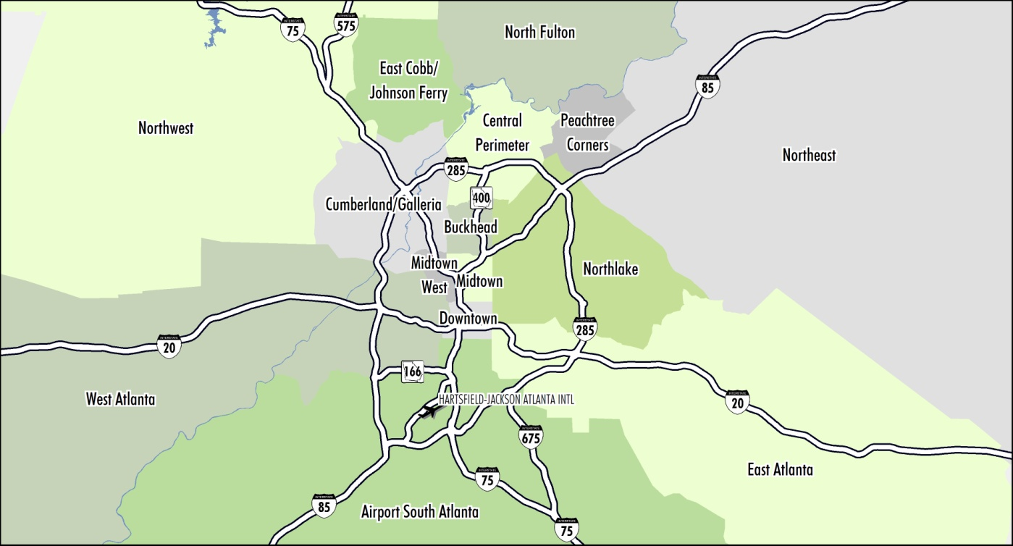
Atlanta Market Overview
Atlanta
Office – Incremental Improvement
• New Relocations and Expansions
• Big Blocks Dwindling
• New Acquisition Cycle–Catalyst to Push Rates
• On Cusp of New Development Cycle
• Workplace Strategy/Trends
• GA 400/MARTA “Spine” Market Most Attractive
• The Need for Speed–Connectivity
• Walkability Wins
• Capital market activity levels for office properties up sharply (Y-o-Y) in Atlanta and Southeast

Slide 11
Atlanta Market Overview
Atlanta
Office –Improving Fundamentals
Class A properties lead Atlanta office vacancy decreases while overall net absorption remains consistent quarter over quarter.
Sq. Ft. (millions)

Slide 12
Atlanta Market Overview
Atlanta
Office –Improving Fundamentals
Core office absorption in the Buckhead, Central Perimeter, and Midtown submarkets has comprised the majority of leasing activity in the metro.

Slide 13
Atlanta Market Overview
Atlanta
Office –Improving Fundamentals
Similar to vacancy rates, Class A properties lead Atlanta office rate increases which has pushed the overall rate into an upward trend even while Class B remains stagnant.

Slide 14
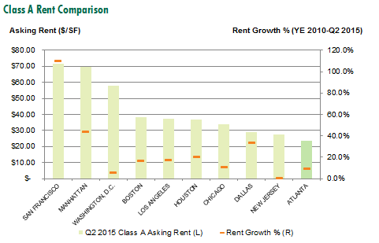
Atlanta Market Overview
Atlanta
Office – A Bargain Nationally
The recent rate of Class A rental increases in CBD markets in Dallas, Manhattan and San Francisco span anywhere between 33% and 110%. A Class A tenant in downtown San Francisco that signed a lease for $43 per square foot in 2010 could be faced with a whopping $71 renewal rate today.

Slide 15
Atlanta Market Overview
Atlanta
Office –Limited New Development
As vacancy rates still have more runway to go before reaching 10%, there is limited new development occurring. The city is on the cusp of a new development cycle.
Sq. Ft. (millions)
Three Alliance in Buckhead will add 500k sq. ft. once complete in 2016.

Slide 16
Atlanta Market Overview
Atlanta
Office –Investment Trending Upward
Office sales volume has taken off since mid-2012 as sidelined capital returned to the Atlanta metro. Cap rates have also seen compression as there is little available Class A product available for acquisition.
Sq. Ft. (millions)
Class-A, core submarket assets have become in higher demand over the past 24 month period.

Slide 17
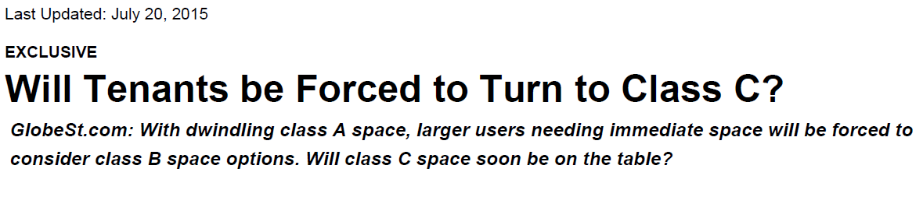
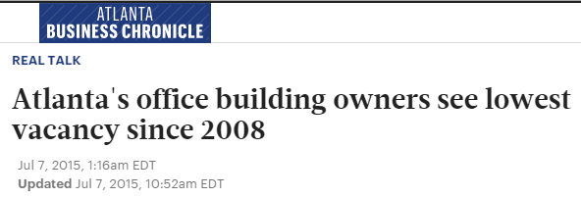
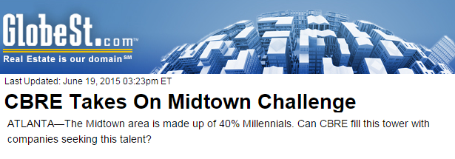

Atlanta Market Overview
Atlanta
Recent Office Headlines

Slide 18
Types of Office Buildings
Type of Building:
CBD
Corporate
Multi-tenant; Suburban
Government
Medical (MOB)
Owner Occupied
Single Purpose
Build to Suit
Single Tenant, NNN Lease
Financial/Banks
Valuation Issues:
Sales, Tenancy, Class, Occupancy
Features, Marketability, Rents, Comps
Vacancy, Concessions, LUD
Term, Renewals, Expenses, Location
FF&E, Ownership/Rent, Location
Income Approach?, Fee Simple, LUD
Renewals, Tis, Sales, Marketability
Rent, RoC, Renewal, Marketability
Term, Credit, Comps, Escalations
Credit, Alt. Use, FF&E, Drive Thrus

Slide 19
Types of Office Buildings
Property Factor:
Location
Size and Height
Class
Configuration
Building Services
Building Costs
Age
Use and Ownership
Markets Served
Valuation Issues:
Design, Utility, and Value
Zoning, Sponsors, Market, Costs
Trophy, Class A, B, & C
Cost, Appeal, Location, Structure
LEED, Technology, Safety, Amenities
Class, Location, Size, Finish
Utility, Marketability, Value
Owner, Tenant, Gov’t, Mixed-Use
Appeal, Operating Costs, Aesthetics

Slide 20
Market Analysis Overview
Market Analysis:
Demand wwwwwwwwwwwwwwwwwwwwwwwwwwwwwwwwwwwwwwwwwww
Supply wwwwwwwwwwwwwwwwwwwwwwwwwwwwwwwwwwwwwwwwwww
Absorption
Rents wwwwwwwwwwwwwwwwwwwwwwwwwwwwwwwwwwwwwwwwwww
Why important? wwwwwwwwwwwwwwwwwwwwwwwwwwwwwwwwwwwwwwwwwww
Sources of Data
Trends
“Office prone” job growth, relocation, absorption vs leasing
Easier, By Class, Existing/construction, vacancy, sublet space
History, capture, pre-leasing, rent
Actual, vacancy, construction, competitive position, outperform
Gain understanding of what constitutes and drives a particular market
Quarterly Market reports, Participant Interviews
Millennials, sustainability, collaborative work space, design, WeWork Building, ATV Building, BofA Tower

Slide 21

Property Data and Interview-Check Lists
Renewal options at below market rents
CAM reconciliation details
Right of first refusal on adjoining spaces
Termination options
Real estate tax credits
Amortization of above market TI’s
Base Year Stops for each tenant

Slide 22
The Three Approaches to Value
Potential Pitfalls and Concerns in each
Cost Approach
Sales Comparison Approach
Income Capitalization Approach

Slide 23
Cost Approach
Cost Approach

Slide 24

Cost Approach
Area of concern in the Cost approach
MVS Cost Estimates – We all use it, do we understand it?
Base cost number - what it includes, what is not included?
Land – HBU; Zoning; As Is Value?
Depreciation or stop at RCN?
Fee Simple Value / Stabilized
Entrepreneurial Profit
Profit before or after land?

Slide 25
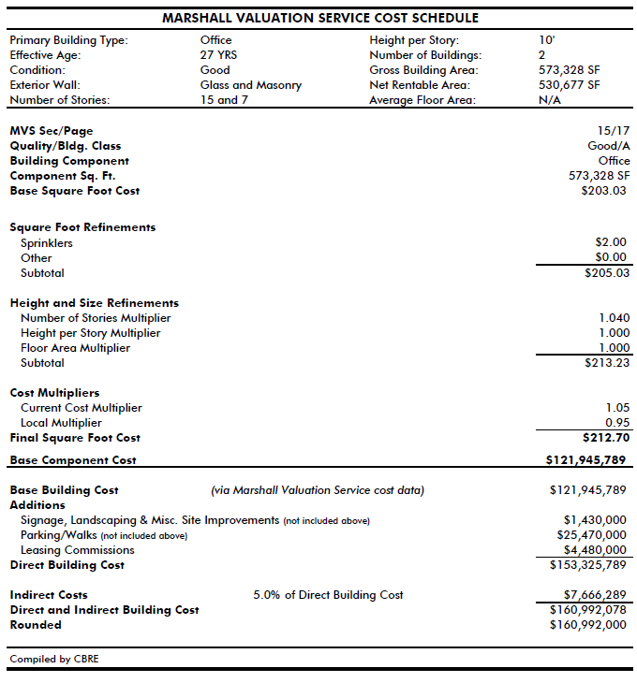
Cost Approach

Slide 26
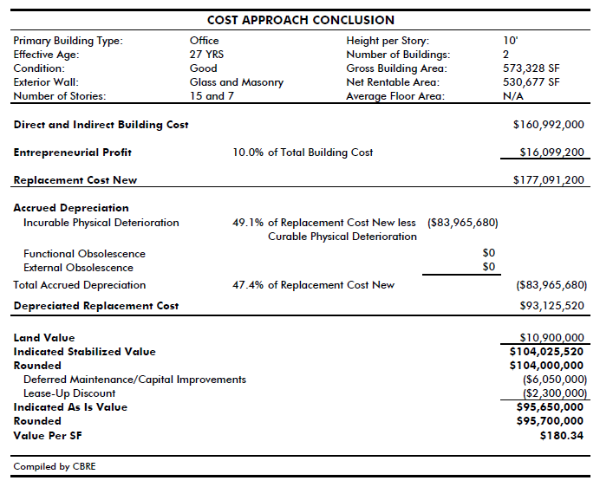
Cost Approach

Slide 27
Sales Comparison Approach
Sales Comparison Approach

Slide 28

Sales Comparison Approach
Involves comparing sales and listings to the property being valued and adjusting for relevant elements of comparison
Most relevant for land and vacant properties which are most likely to be purchased by a user
Value to a user is often higher than “investor” value – investor has to assume the risks and costs of lease-up
For income property, the Sales Comparison Approach is mostly used as a check of reasonableness – “price per pound”
The Sales Comparison Approach
involves substantial judgment.

Slide 29
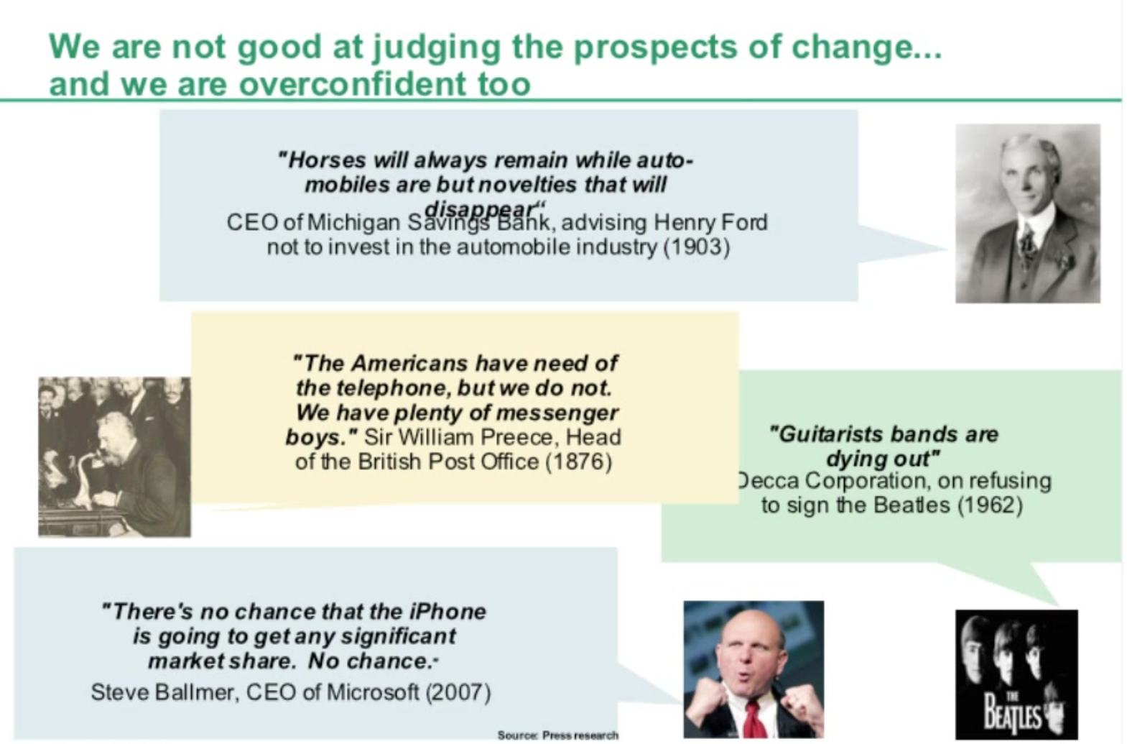
Sales Comparison Approach

Slide 30
Sales Comparison Approach
Elements of Adjustment
Transactional Adjustments
Property Rights Conveyed
Market Conditions / Time
Property Adjustments
Location
Financing Terms
Conditions of Sale
Capital Expenditures
Physical Characteristics
Economic / Income Characteristics
Use / Zoning
Non-Realty Components

Slide 31

Sales Comparison Approach
Is the Comparable Data Adequate?
Property rights – leased fee, leasehold, fee simple
Quality of comparables
Lease terms – length, type (NNN or gross)
Adjusted price
Expense ratios
Expirations – impact of near term rollover
Stabilized or As Is?

Slide 32

Sales Comparison Approach
Lack of Sales COmparables
What do you do?
Do you perform the SCA?
Expand the area of search
Adjust the time period
Use two sets of comparables:
  Fee Simple (PSF)
  Leased Fee (OAR)

Slide 33



Sales Comparison Approach
NOI Adjustment
Should we use it?
Where? Income approach or SCA?
Reciprocal of the Cap Rate
Tenancy
Leased fee or fee simple?
Single or Multi-tenant?
Creditworthy?
LUD DEDUCT
The use depend on your sales
Were the sales stabilized?

Slide 34
Income Approach
Income Approach

Slide 35


Income Approach
Interview with Market Participants
Bob Voyles
Seven Oaks Company
Principal, Chief Executive Officer
Will Yowell
CBRE, Inc.
Vice Chairman, Investment Properties

Slide 37
Income Approach
Ownership Interest Being Valued:
Fee Simple vs. Leased Fee Interest VS. LEASEHOLD
Fee Simple
“Absolute ownership unencumbered by any other interest or estate, subject only to the limitations imposed by the governmental powers of taxation, eminent domain, police power and escheat.”
Leased Fee
“A freehold (ownership interest) where the possessory interest has been granted to another party by creation of a contractual landlord-tenant relationship (i.e., a lease).”
Leasehold Estate
“Ownership of a temporary right to hold land or property in which a lessee or a tenant holds rights of real property by some form of title from a lessor or landlord.”

Slide 38
Income Approach
Ownership Interest Being Valued:
Fee Simple vs. Leased Fee Interest VS. LEASEHOLD
Items to Consider
Property Rights Adjustment and performing it properly
Lease up discount calculation and its application.

Slide 39
Income Approach
Value Type
Stabilized – Value of a property after construction has been completed and market occupancy and cash flow have been achieved
As Is – Value of real estate as of the effective date of the appraisal
Prospective - Value opinion effective as of a specified future date

Slide 40

Income Approach
Rent Comps
Make sure you specify whether or not a comparable rate is Quoted or Actual
Income and Expenses
These estimates often depend on the current cycle in the market on the transactional side.
Data Available
Trailing 12-months; Historical
In-Place
Pro Forma
Reserves

Slide 41
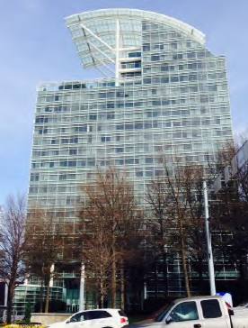

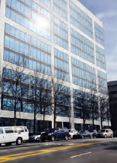


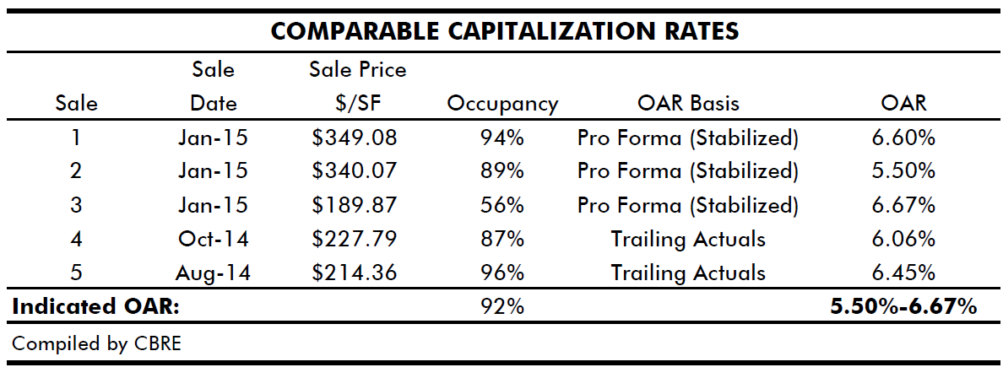
Direct Capitalization
Methods of Estimating Cap Rate:
Comparables
1
2
3
4
5

Slide 42
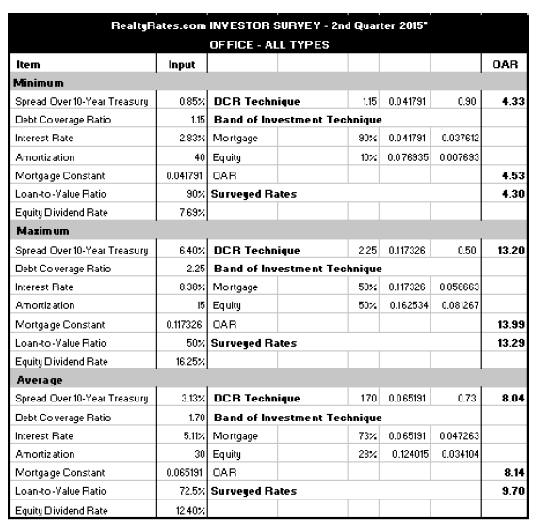
Direct Capitalization
Methods of Estimating Cap Rate:
Comparables
Published Surveys
Realty Rates is useful for not only obtaining overall cap rates.
Loan-to-Value Ratios
Debt Coverage Ratios
Interest Rates
Equity Dividend Rates

Slide 43
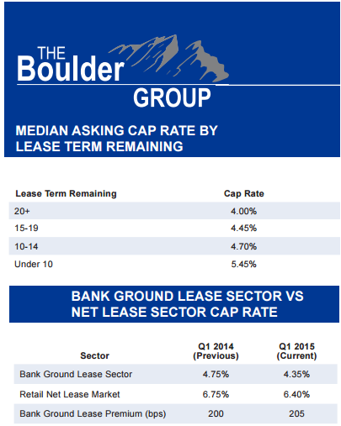
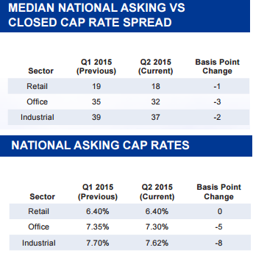
Direct Capitalization
Methods of Estimating Cap Rate:
Comparables
Published Surveys

Slide 44
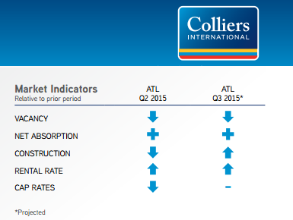
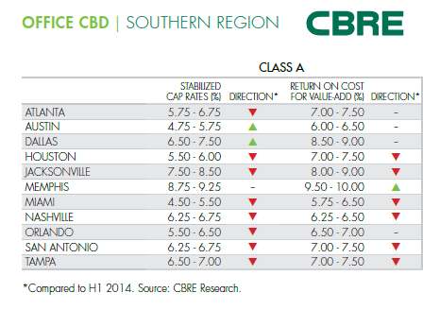
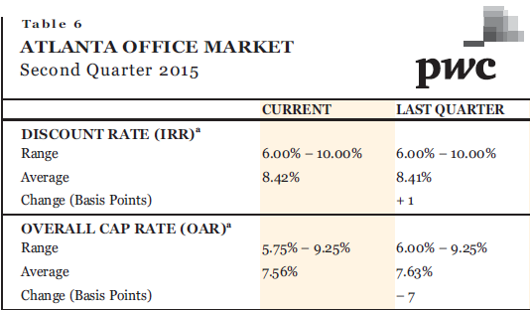
Direct Capitalization
Methods of Estimating Cap Rate:
Comparables
Published Surveys

Slide 45
Direct Capitalization
Methods of Estimating Cap Rate:
Comparables
Published Surveys
CBRE, Inc. cbre.com/research
Marcus and Millichap marcusmillichap.com
PwC Investor Survey pwc.com
Realty Rates realtyrates.com
Cushman & Wakefield cushmanwakefield.com/knowledge
The Boulder Group bouldergroup.com
NCREIF ncreif.com
Colliers International colliers.com
RERC Real Estate Reports rerc.com
REIS reis.com
Caprates.net

Slide 46
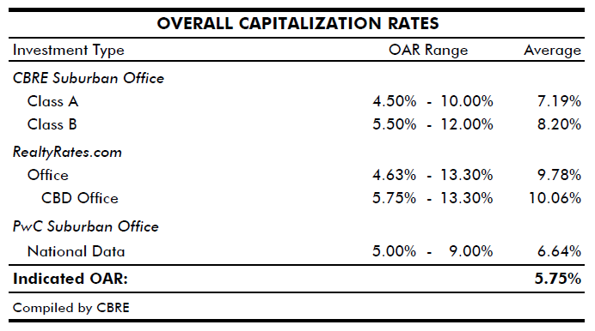
Direct Capitalization
Methods of Estimating Cap Rate:
Comparables
Published Surveys

Slide 47




Direct Capitalization
Methods of Estimating Cap Rate:
Comparables
Published Surveys
Market Participant Interviews

Slide 48
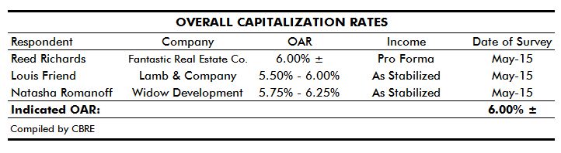
Direct Capitalization
Methods of Estimating Cap Rate:
Comparables
Published Surveys
Market Participant Interviews
“Get a second… and third opinion.”

Slide 49
Direct Capitalization
Methods of Estimating Cap Rate:
Comparables
Published Surveys
Market Participant Interviews
Band of Investment
What are the sources of your rates?
Remember: EDR > OAR and Mortgage Rate

Slide 50
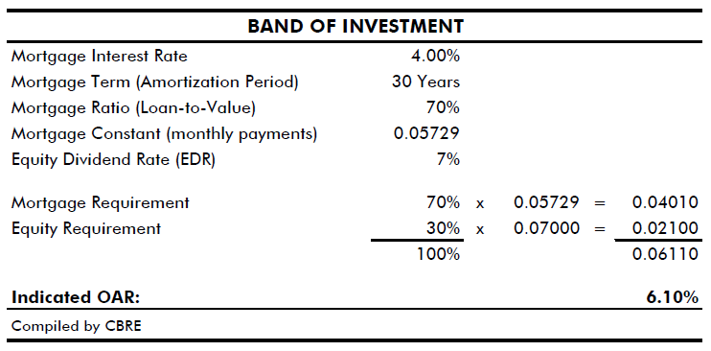
Direct Capitalization
Methods of Estimating Cap Rate:
Comparables
Published Surveys
Market Participant Interviews
Band of Investment

Slide 51
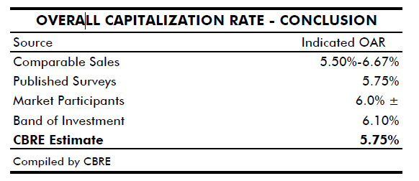
Direct Capitalization
Methods of Estimating Cap Rate:
Reconciliation
In concluding an overall capitalization rate for the subject, primary reliance has been placed upon the data obtained from the comparable sales and interviews with active market participants.

Slide 52

Income Approach

Slide 53
Discounted Cash Flow
Discounted Cash Flow Analysis
Sources of estimating discount rate - similar to cap rate, not as available.
Spread in bps over OAR - NOI growth rate, inflation, surveys
Term - 10 years?
Vacancy - General, Downtime, Both
Growth Rates - Income and Expenses
TIs and Leasing Commissions
Reversion - cap rate, year, gross up?
% Reversion to NPV

Slide 54

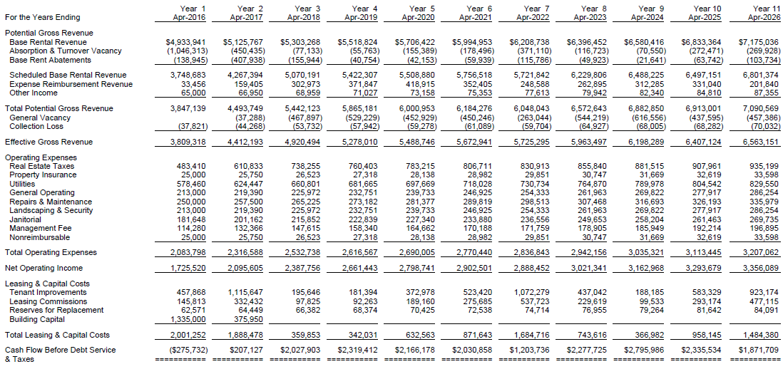
Discounted Cash Flow
DCF SCENARIO Analysis

Slide 55

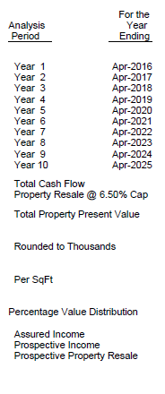
Discounted Cash Flow
DCF SCENARIO Analysis
BASE SCENARIO
General Vacancy Rate: 10%
Option: Reduce General Vacancy Result by Absorption & Turnover Vacancy
Months Vacant: 6 Months
Renewal Probability: 70%

Slide 56




Discounted Cash Flow
DCF SCENARIO Analysis - Renewal Probability
Renewal Probability Scenarios
Base Scenario
70% RP
50% RP
60% RP
80% RP
90% RP

Slide 57



Discounted Cash Flow
DCF SCENARIO Analysis - Vacancy
Pct Based on Rev Minus Abs
Base
Scenario
Both
Options
No Gen.Vac.
22 mth vac.

Slide 58

Discounted Cash Flow
DCF SCENARIO Analysis – Property Resale
Base Scenario
Cap NOI
Grossed up to stabilized
Market vacancy of 10%

Slide 59
Appraisal Curve Balls
Curve Balls
Taxes
State Law
Value to Tax Value
“Do Sales Trigger a reassessment?”

Slide 60
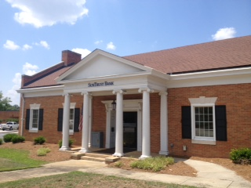
Appraisal Curve Balls
Curve Balls
Ground Leases
Expense it or deduct leased fee?
Risk – “Have you adjusted the cap rate?”
Term
Alternative Yields
Subordinated – Is it? Yes / No

Slide 61

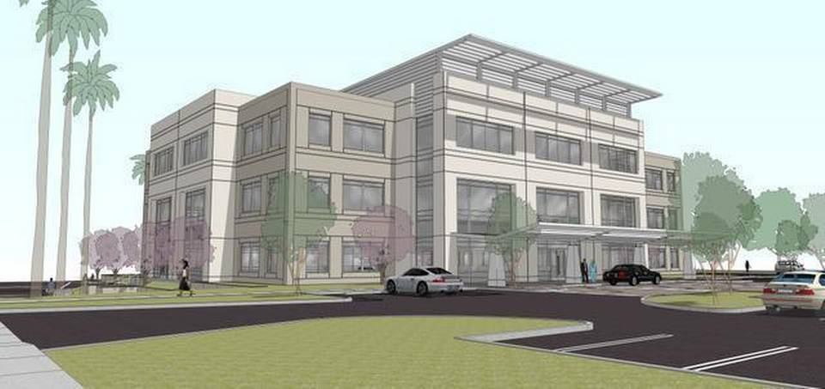
Appraisal Curve Balls
Curve Balls
Expansion Options / Renewals
Account for Below Market Options
How to treat?
Proposed Buildings
Future Estimates
Market Rate
Absorption and Lease Up

Slide 62

Appraisal Curve Balls
Curve Balls
Fee Simple “Go Dark” Analysis
The fee simple analysis assumes the subject property to be vacant and available for lease, and is often referred to as a “go dark” analysis.

Slide 63
Appraisal Curve Balls
Curve Balls
Fee Simple “Go Dark” Analysis – Steps to Take
Estimate appropriate market rent;
Estimate applicable stabilized vacancy & collection loss factors;
Adjust expenses estimates if necessary;
Adjust OAR due to risk for alternative tenancy;
Estimate an appropriate period to lease-up the improvements;
Provide an allowance for leasing commissions;
Provide an allowance for tenant improvement/retrofit costs;
Estimate developers profit;

Slide 64
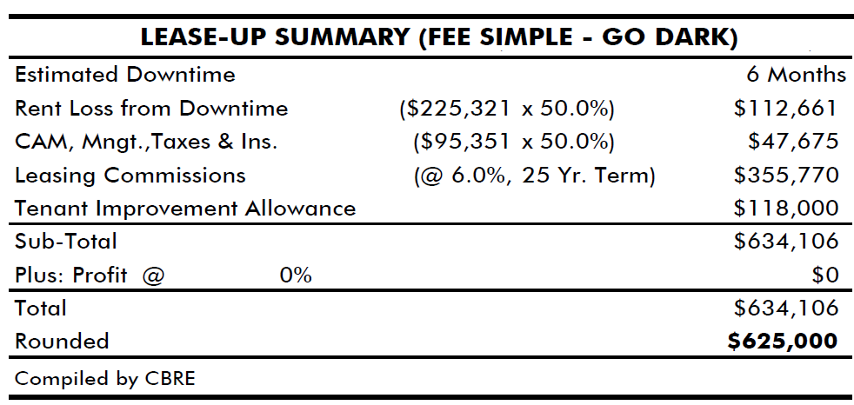
Appraisal Curve Balls
Curve Balls
Fee Simple “Go Dark” Analysis

Slide 65
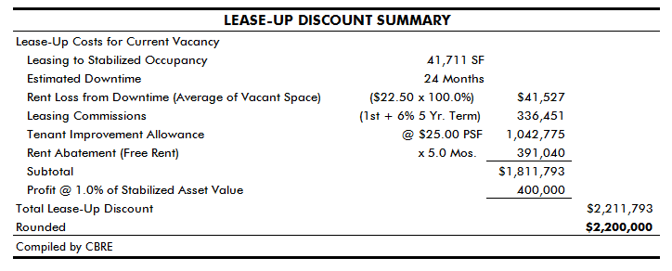
Appraisal Curve Balls
Curve Balls
Lease-Up Discount
The discount required to account for the expenses incurred before the property achieves a stabilized occupancy.

Slide 66
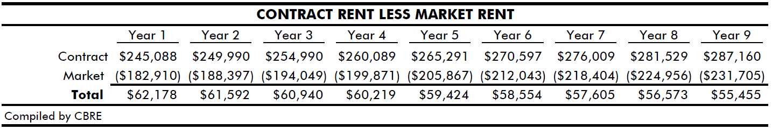
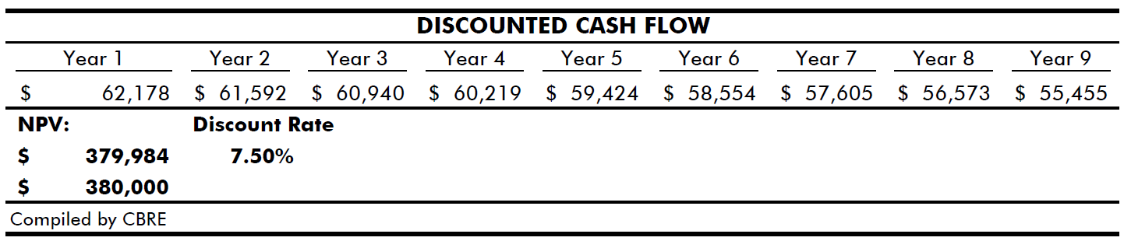
Appraisal Curve Balls
Curve Balls
Above Market Rents
“In recognition of the subject’s above market rental rate, we have taken the present value lump sum of the difference between market rent and contract rent and added it to our direct capitalization value conclusion. For our purposes, we have assumed that market rent will grow by 3.00% annually. The tables below outline the calculations:”

Slide 67








New Office Designs
An odd exterior is nothing new….

Slide 68

New Office Designs

Slide 69

New Office Designs

Slide 70

New Office Designs

Slide 71

New Office Designs

Slide 72
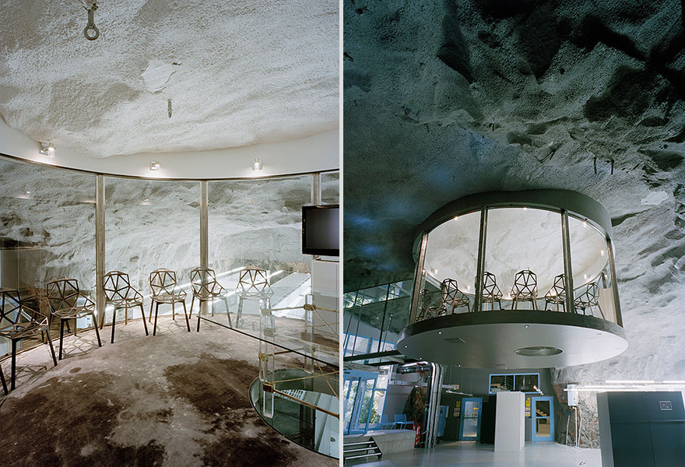
New Office Designs

Slide 73

New Office Designs

Slide 74

New Office Designs

Slide 75

New Office Designs

Slide 76

New Office Designs
CBRE Los Angeles - Workplace 360

Slide 77

Contact Information
John W. Cherry Jr., MAI, CRE
Managing Director
Valuation & Advisory Services
John.Cherry@cbre.com
404.812.5028
Meet the National Office Valuation Team

Slide 78
Q&A Session

